Slide 1


Slide 2

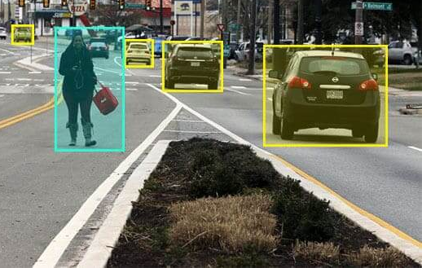
Introduction to mAP
The sample image on the right has 5 annotated labels.
After training our ML models, how do we evaluate the effectiveness of our models?
ANS: Mean Average Precision (mAP)
Image Source: Sample photo from MS COCO dataset

Slide 3
Introduction to mAP
To calculate mAP, we first need to know Precision and Recall.
Precision measures how accurate your predictions are.
Recall measures the percentage of all the positives ground truth correctly classified.
Image Source: Sample photo from MS COCO dataset

Slide 4
Introduction to mAP
The sample image on the right has 5 annotated labels.
Assume that IoU > 0.5 is a correct prediction.
Rank | IoU > 0.5 | Precision | Recall
1 | True | 1/1 = 1 | 1/5= 0.2
2 | True | 2/2 = 1 | 2/5 =0.4
3 | False | 2/3 = 0.67 | 2/5 = 0.4
Image Source: Sample photo from MS COCO dataset

Slide 5
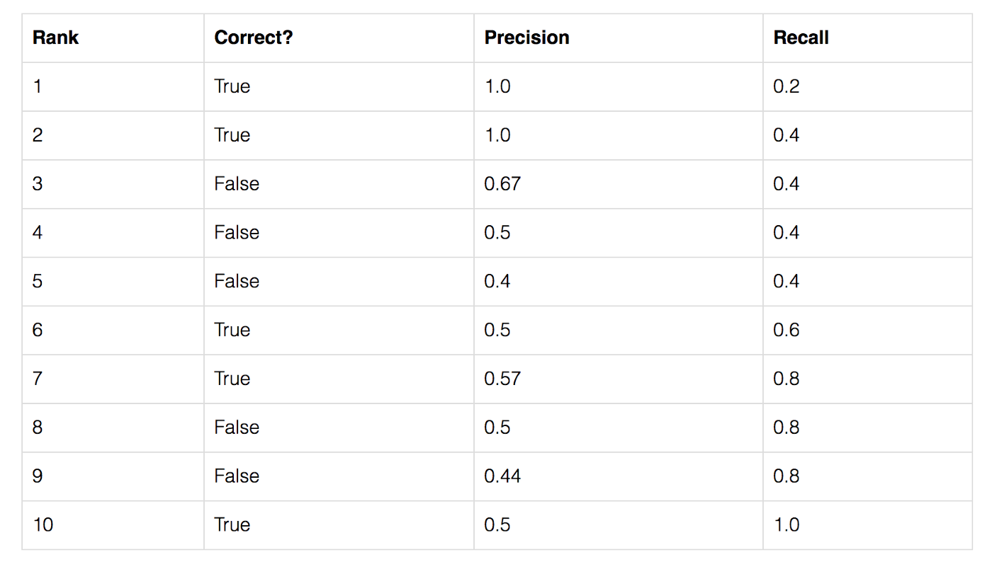
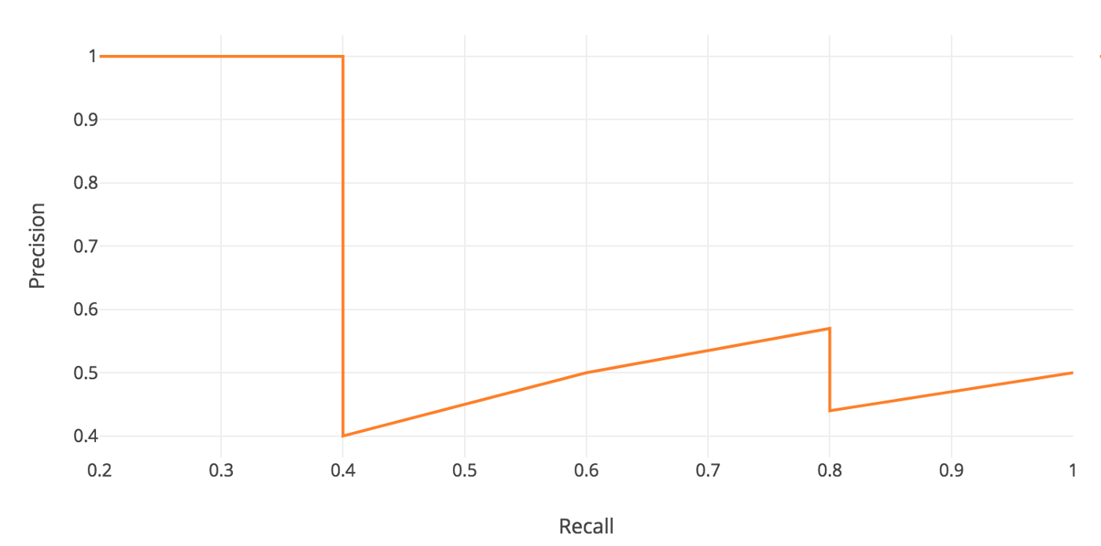
Introduction to mAP
Plotting Precision Recall Curve
Image Source: Medium (mAP)
Notes:
https://medium.com/@jonathan_hui/map-mean-average-precision-for-object-detection-45c121a31173

Slide 6
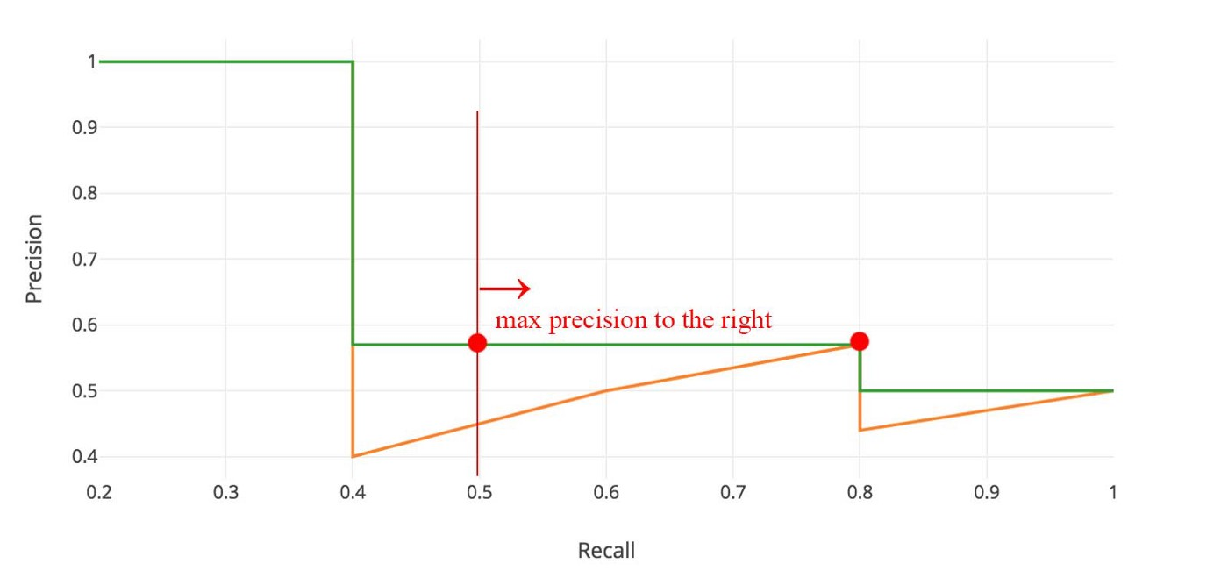
Introduction to mAP
Plotting Precision Recall Curve
Image Source: Medium (mAP)
Notes:
https://medium.com/@jonathan_hui/map-mean-average-precision-for-object-detection-45c121a31173

Slide 7
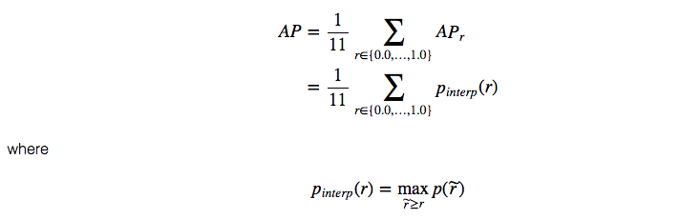
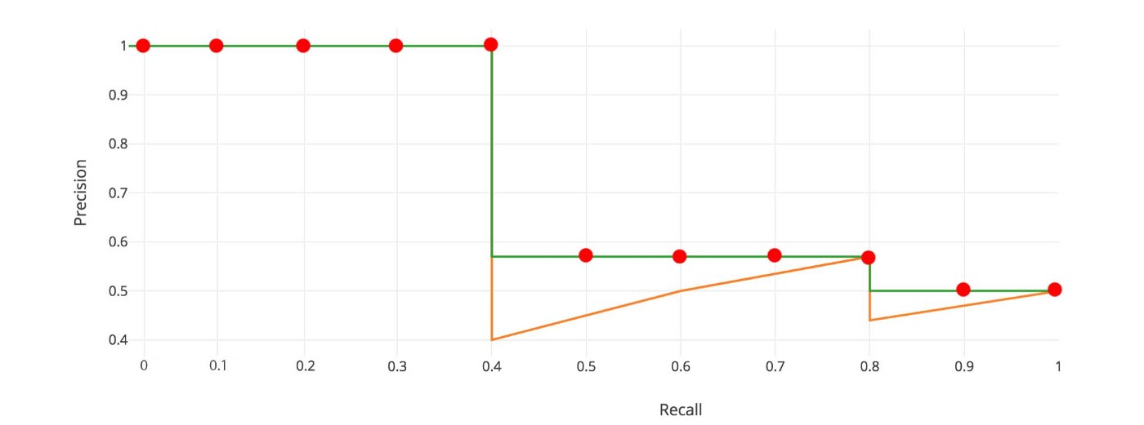
Introduction to mAP
Plotting Precision Recall Curve
Calculating mAP
First, we divide the recall value from 0 to 1.0 into 11 points — 0, 0.1, 0.2, …, 0.9 and 1.0.
Next, we compute the average of maximum precision value for these 11 recall values.
In our example, AP = (5 × 1.0 + 4 × 0.57 + 2 × 0.5)/11
Image Source: Medium (mAP)
Notes:
https://medium.com/@jonathan_hui/map-mean-average-precision-for-object-detection-45c121a31173

Slide 8
BrainHack Evaluation Metrics
Similar to COCO mAP, we will be using an interpolated AP definition used above for calculation.
Models will be benchmarked according to AP@[.2:.5], the average AP for IoU from 0.2 to 0.5 with a step size of 0.05.
Note: We might change the threshold values in order to distinguish between competing results in the most fair manner possible, and in such a way that no participant is unfairly disadvantaged.

Slide 9
Thank you!

